Slide 1
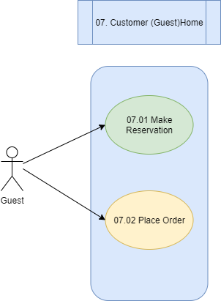
I4: Use-Case Diagrams

Slide 2
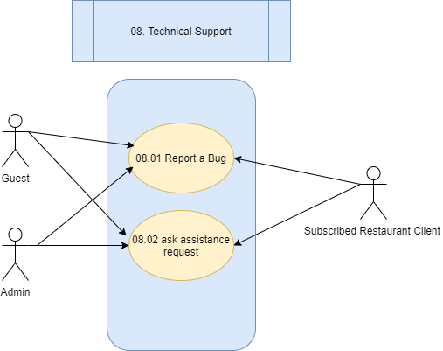
I4: Use-Case Diagrams

